Slide 1
Space-charge-limited current measurements: A problematic technique for metal halide perovskite thin-films Jason A. Röhr, Vincent M. Le Corre --- SCLC literature data

Slide 2
Analysis
Two black rectangles used to reconstruct the log-log grid
True log-log slope of 1
True log-log slope of 2
Ref | Good µ? | TFL Regime Appears? | Position V_{TFL} | Mention Ions? | Correct Ohmic slope? | Correct SCLC Slope? | Report scan speed? | Measure (+)/(-) voltages? | Show Hysteresis sweep? | Used pulsed-SCLC? | Wrong conclusion?
 | 0 = no 1 = yes | 0 = no 1 = yes | 0 = V_{ons} 1 = V_{end} | 0 = no 1 = yes | 0 = no 1 = yes | 0 = no 1 = yes | 0 = no 1 = yes | 0 = no 1 = yes | 0 = no 1 = yes | 0 = no 1 = yes | 0 = no 1 = yes

Slide 3
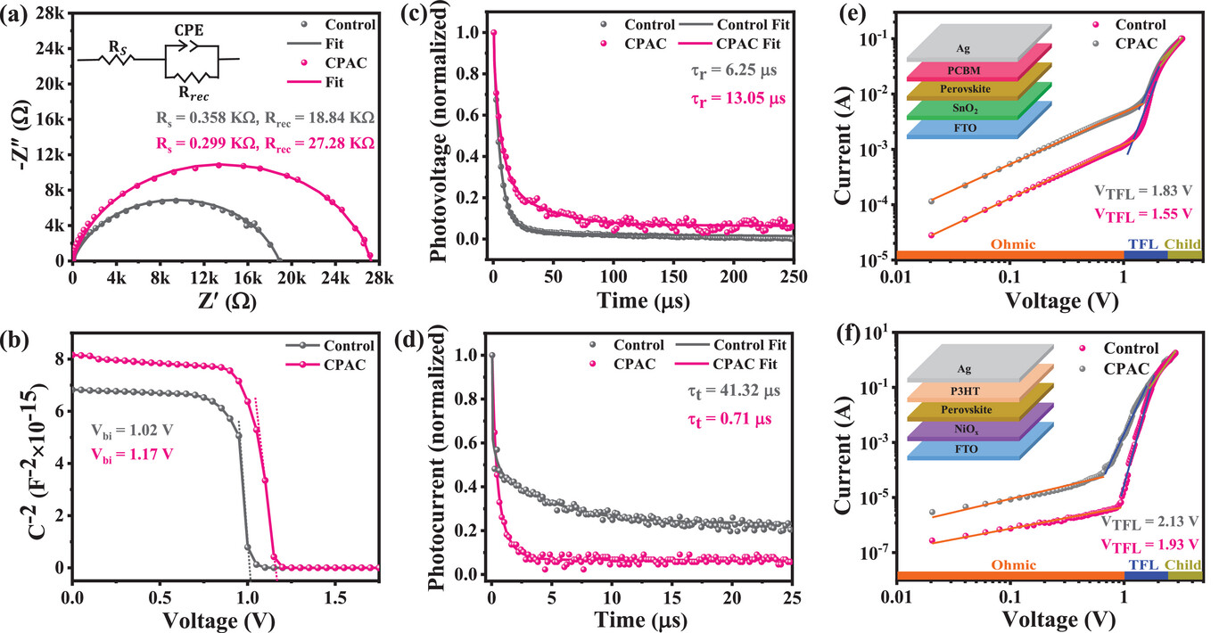
Ref | Good µ | TFL regime | Position V_{TFL} | Mention ions | Ohmic slope | SCLC slope | Report scan speed | Measure (+)/(-) voltages | Hysteresis sweep | pulsed-SCLC | Wrong conclusion
https://doi.org/10.1002/aenm.202402473 |  | 1 | 1 | 0 | 1 | 0 | 0 | 0 | 0 | 0 | 0

Slide 4
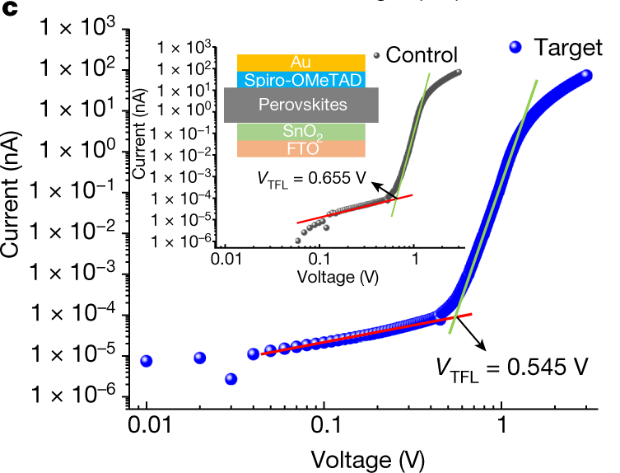
Ref | Good µ | TFL regime | Position V_{TFL} | Mention ions | Ohmic slope | SCLC slope | Report scan speed | Measure (+)/(-) voltages | Hysteresis sweep | pulsed-SCLC | Wrong conclusion
https://doi.org/10.1038/s41586-023-05825-y |  | 1 | 0 | 0 | 1 | 1 | 0 | 0 | 0 | 0 | 1

Slide 5
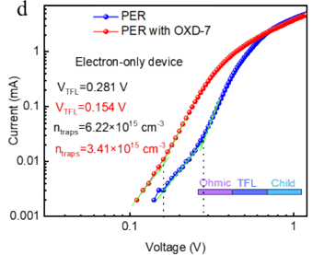
Ref | Good µ | TFL regime | Position V_{TFL} | Mention ions | Ohmic slope | SCLC slope | Report scan speed | Measure (+)/(-) voltages | Hysteresis sweep | pulsed-SCLC | Wrong conclusion
https://dx.doi.org/10.2139/ssrn.4896723 | 0 | 1 | 0 | 0 | 0 | 0 | 0 | 0 | 0 | 0 | 0

Slide 6
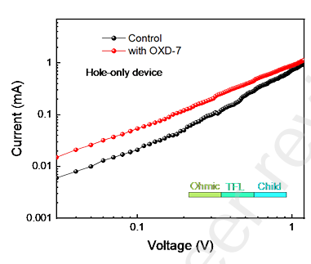
Ref | Good µ | TFL regime | Position V_{TFL} | Mention ions | Ohmic slope | SCLC slope | Report scan speed | Measure (+)/(-) voltages | Hysteresis sweep | pulsed-SCLC | Wrong conclusion
https://dx.doi.org/10.2139/ssrn.4896723 | 0 | 0 | nan | 0 | 1 | 0 | 0 | 0 | 0 | 0 | 0

Slide 7
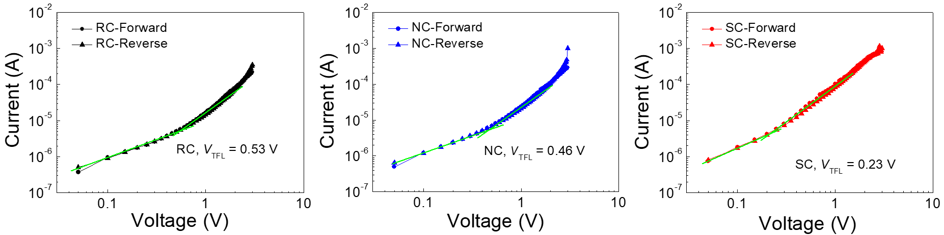
Ref | Good µ | TFL regime | Position V_{TFL} | Mention ions | Ohmic slope | SCLC slope | Report scan speed | Measure (+)/(-) voltages | Hysteresis sweep | pulsed-SCLC | Wrong conclusion
https://doi.org/10.1002/adma.202405840 |  | 0 | 0 | 1 | 1 | 1 | 1 | 0 | 1 | 1 | 0

Slide 8
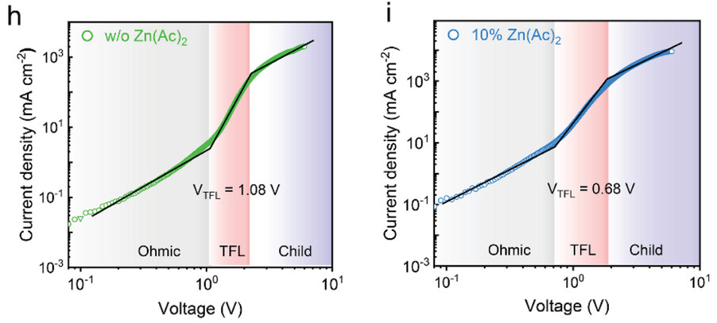
Ref | Good µ | TFL regime | Position V_{TFL} | Mention ions | Ohmic slope | SCLC slope | Report scan speed | Measure (+)/(-) voltages | Hysteresis sweep | pulsed-SCLC | Wrong conclusion
https://doi.org/10.1002/smll.202402825 |  | 1 | 0 | 0 | 0 | 1 | 0 | 0 | 0 | 0 | 0

Slide 9
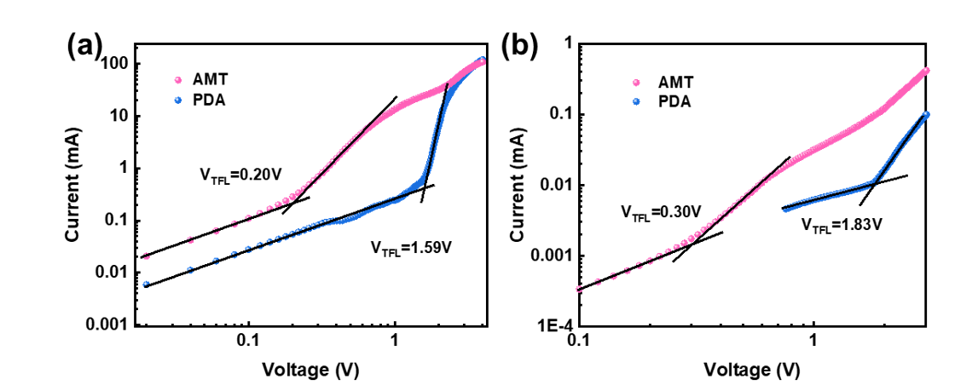
Ref | Good µ | TFL regime | Position V_{TFL} | Mention ions | Ohmic slope | SCLC slope | Report scan speed | Measure (+)/(-) voltages | Hysteresis sweep | pulsed-SCLC | Wrong conclusion
https://doi.org/10.1002/aenm.202401907 | 0 | 1 | 0 | 0 | 0 | 0 | 0 | 0 | 0 | 0 | 0

Slide 10
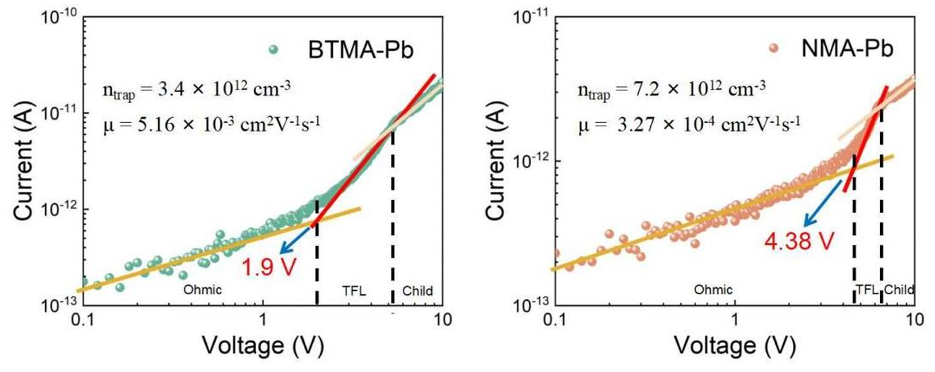
Ref | Good µ | TFL regime | Position V_{TFL} | Mention ions | Ohmic slope | SCLC slope | Report scan speed | Measure (+)/(-) voltages | Hysteresis sweep | pulsed-SCLC | Wrong conclusion
https://doi.org/10.1002/adfm.202403746 | 0 | 1 | 0 | 0 | 0 | 0 | 0 | 0 | 0 | 0 | 1

Slide 11
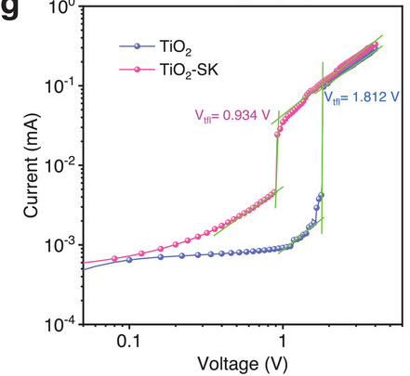
Ref | Good µ | TFL regime | Position V_{TFL} | Mention ions | Ohmic slope | SCLC slope | Report scan speed | Measure (+)/(-) voltages | Hysteresis sweep | pulsed-SCLC | Wrong conclusion
https://doi.org/10.1002/advs.202402796 |  | 1 | 0 | 0 | 0 | 0 | 0 | 0 | 0 | 0 | 0

Slide 12
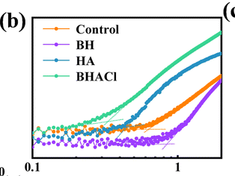
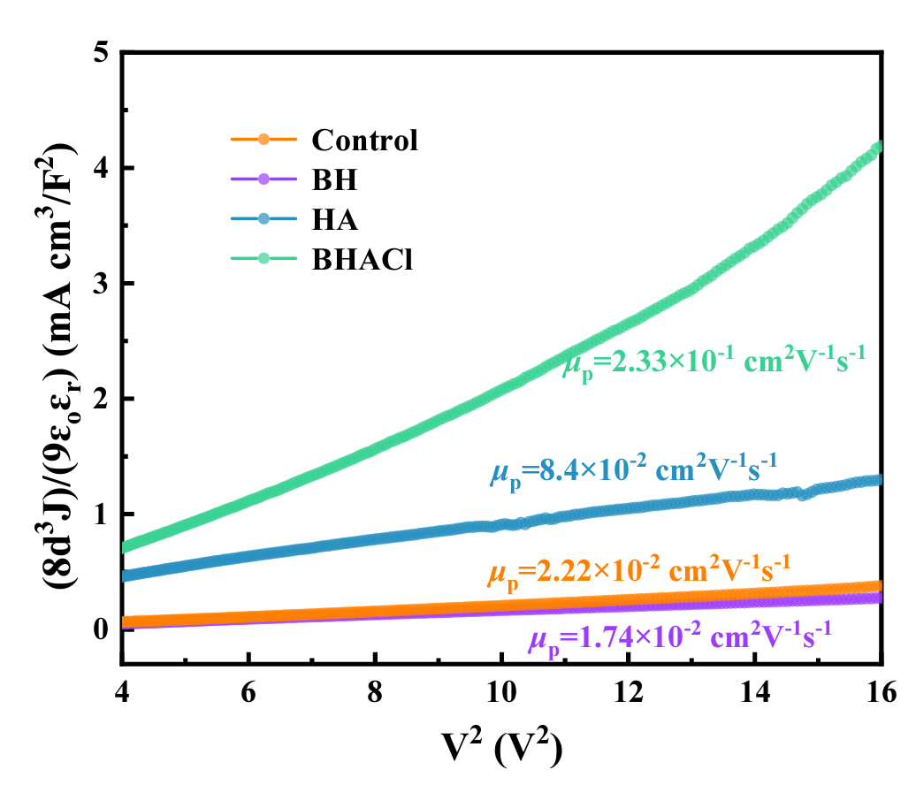
Ref | Good µ | TFL regime | Position V_{TFL} | Mention ions | Ohmic slope | SCLC slope | Report scan speed | Measure (+)/(-) voltages | Hysteresis sweep | pulsed-SCLC | Wrong conclusion
https://doi.org/10.1039/D4TC00719K | 0 |  | 0 | 0 | 0 | 0 | 0 | 0 | 0 | 0
No Y-axis scale!

Slide 13
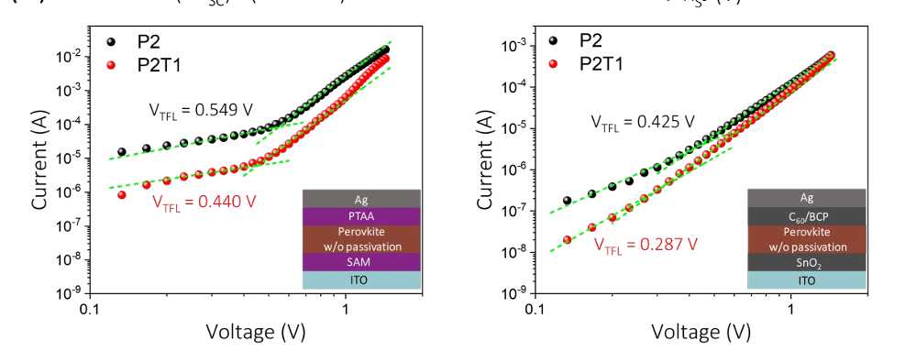
Ref | Good µ | TFL regime | Position V_{TFL} | Mention ions | Ohmic slope | SCLC slope | Report scan speed | Measure (+)/(-) voltages | Hysteresis sweep | pulsed-SCLC | Wrong conclusion
https://doi.org/10.1021/acsami.4c05838 |  | 1 | 0 | 0 | 0 | 0 | 0 | 0 | 0 | 0 | 1

Slide 14
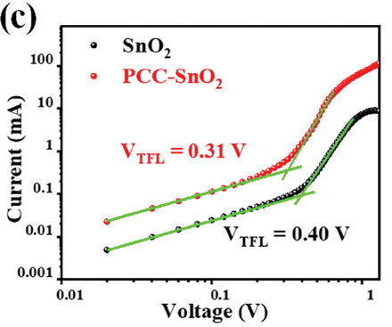
Ref | Good µ | TFL regime | Position V_{TFL} | Mention ions | Ohmic slope | SCLC slope | Report scan speed | Measure (+)/(-) voltages | Hysteresis sweep | pulsed-SCLC | Wrong conclusion
https://doi.org/10.1002/adfm.202405556 |  | 1 | 0 | 0 | 1 | 1 | 0 | 0 | 0 | 0 | 0

Slide 15
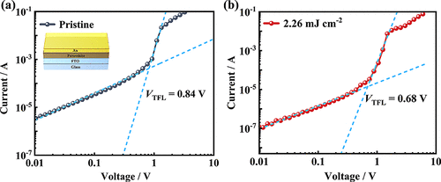
Ref | Good µ | TFL regime | Position V_{TFL} | Mention ions | Ohmic slope | SCLC slope | Report scan speed | Measure (+)/(-) voltages | Hysteresis sweep | pulsed-SCLC | Wrong conclusion
https://doi.org/10.1021/acsaelm.4c00218 |  | 1 | 0 | 0 | 1 | 1 | 0 | 0 | 0 | 0 | 1

Slide 16
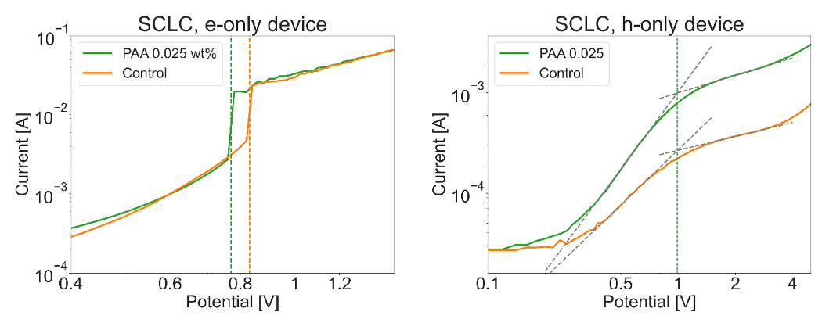
Ref | Good µ | TFL regime | Position V_{TFL} | Mention ions | Ohmic slope | SCLC slope | Report scan speed | Measure (+)/(-) voltages | Hysteresis sweep | pulsed-SCLC | Wrong conclusion
https://doi.org/10.1016/j.xcrp.2024.102058 |  | 1 | 1 | 1 | 0 | 0 | 0 | 0 | 0 | 0

Slide 17
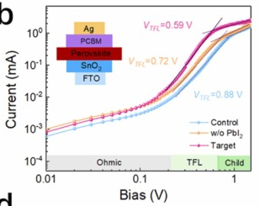
Ref | Good µ | TFL regime | Position V_{TFL} | Mention ions | Ohmic slope | SCLC slope | Report scan speed | Measure (+)/(-) voltages | Hysteresis sweep | pulsed-SCLC | Wrong conclusion
https://doi.org/10.1016/j.nanoen.2024.109875 |  | 1 | 1 | 0 | 1 | 0 | 0 | 0 | 0 | 0 | 0

Slide 18
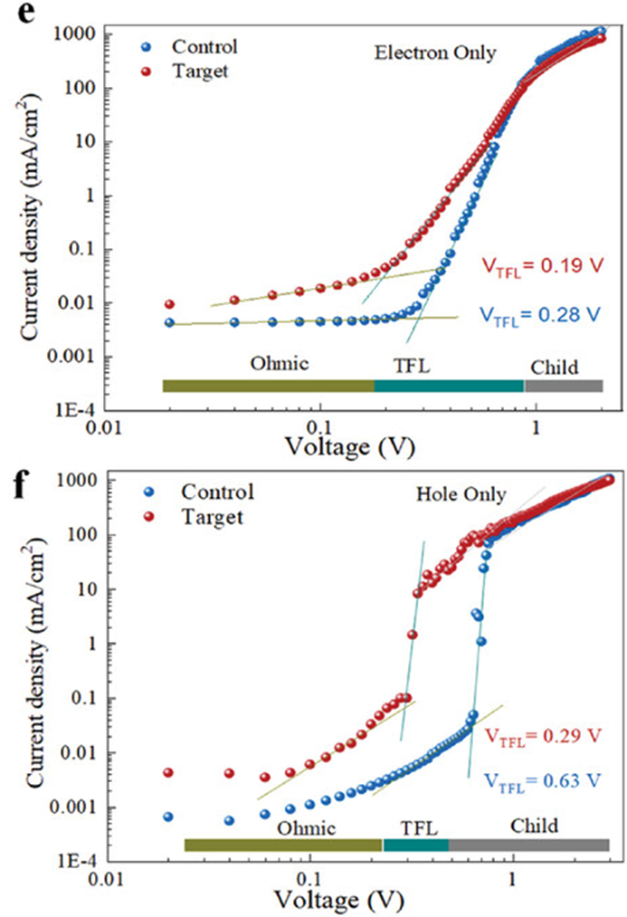
Ref | Good µ | TFL regime | Position V_{TFL} | Mention ions | Ohmic slope | SCLC slope | Report scan speed | Measure (+)/(-) voltages | Hysteresis sweep | pulsed-SCLC | Wrong conclusion
https://doi.org/10.1002/smll.202404334 |  | 1 | 0 | 0 | 0 | 1 | 0 | 0 | 0 | 0 | 1

Slide 19
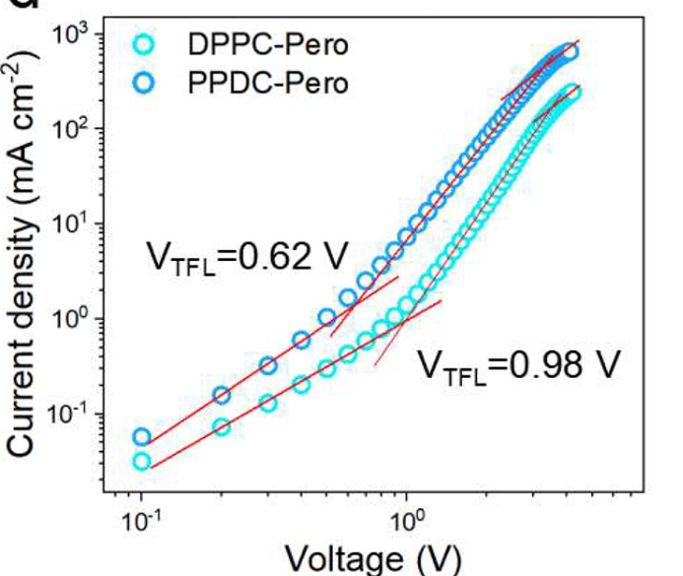
Ref | Good µ | TFL regime | Position V_{TFL} | Mention ions | Ohmic slope | SCLC slope | Report scan speed | Measure (+)/(-) voltages | Hysteresis sweep | pulsed-SCLC | Wrong conclusion
https://doi.org/10.1021/acsami.3c19394 | 1 | 1 | 0 | 0 | 0 | 0 | 0 | 0 | 0 | 0 | 1

Slide 20
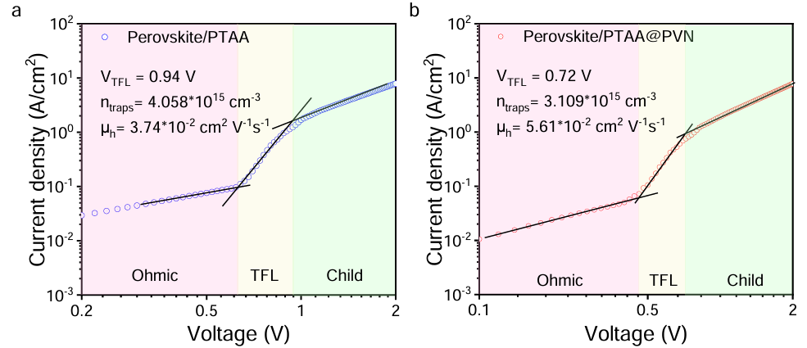
Ref | Good µ | TFL regime | Position V_{TFL} | Mention ions | Ohmic slope | SCLC slope | Report scan speed | Measure (+)/(-) voltages | Hysteresis sweep | pulsed-SCLC | Wrong conclusion
https://doi.org/10.1002/sstr.202400132 | 0 | 1 | 1 | 0 | 0 | 0 | 1 | 0 | 0 | 0 | 0

Slide 21
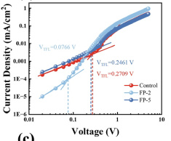
Ref | Good µ | TFL regime | Position V_{TFL} | Mention ions | Ohmic slope | SCLC slope | Report scan speed | Measure (+)/(-) voltages | Hysteresis sweep | pulsed-SCLC | Wrong conclusion
https://doi.org/10.1364/OE.519251 |  | 1 | 0 | 0 | 0 | 0 | 0 | 0 | 0 | 0 | 0

Slide 22
Ref | Good µ | TFL regime | Position V_{TFL} | Mention ions | Ohmic slope | SCLC slope | Report scan speed | Measure (+)/(-) voltages | Hysteresis sweep | pulsed-SCLC | Wrong conclusion
https://doi.org/10.1016/j.cej.2024.152213 | 0 | 0 | 0 | 0 | 0 | 1 | 0 | 0 | 0 | 0 | 1

Slide 23
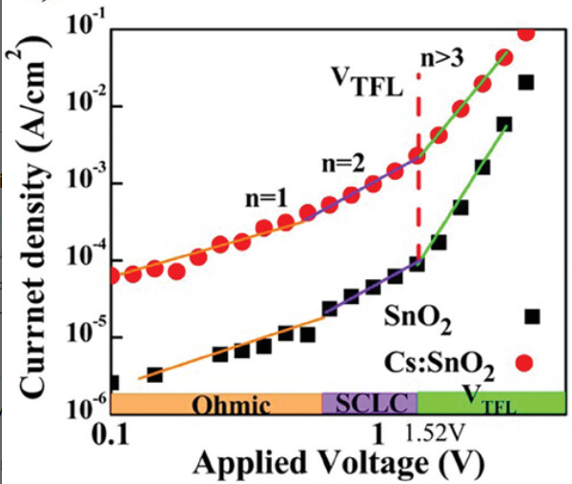
Ref | Good µ | TFL regime | Position V_{TFL} | Mention ions | Ohmic slope | SCLC slope | Report scan speed | Measure (+)/(-) voltages | Hysteresis sweep | pulsed-SCLC | Wrong conclusion
https://doi.org/10.1002/smll.202402268 | 0 | 1 | 0 | 1 | 1 | 0 |  | 0 | 0 | 1

Slide 24
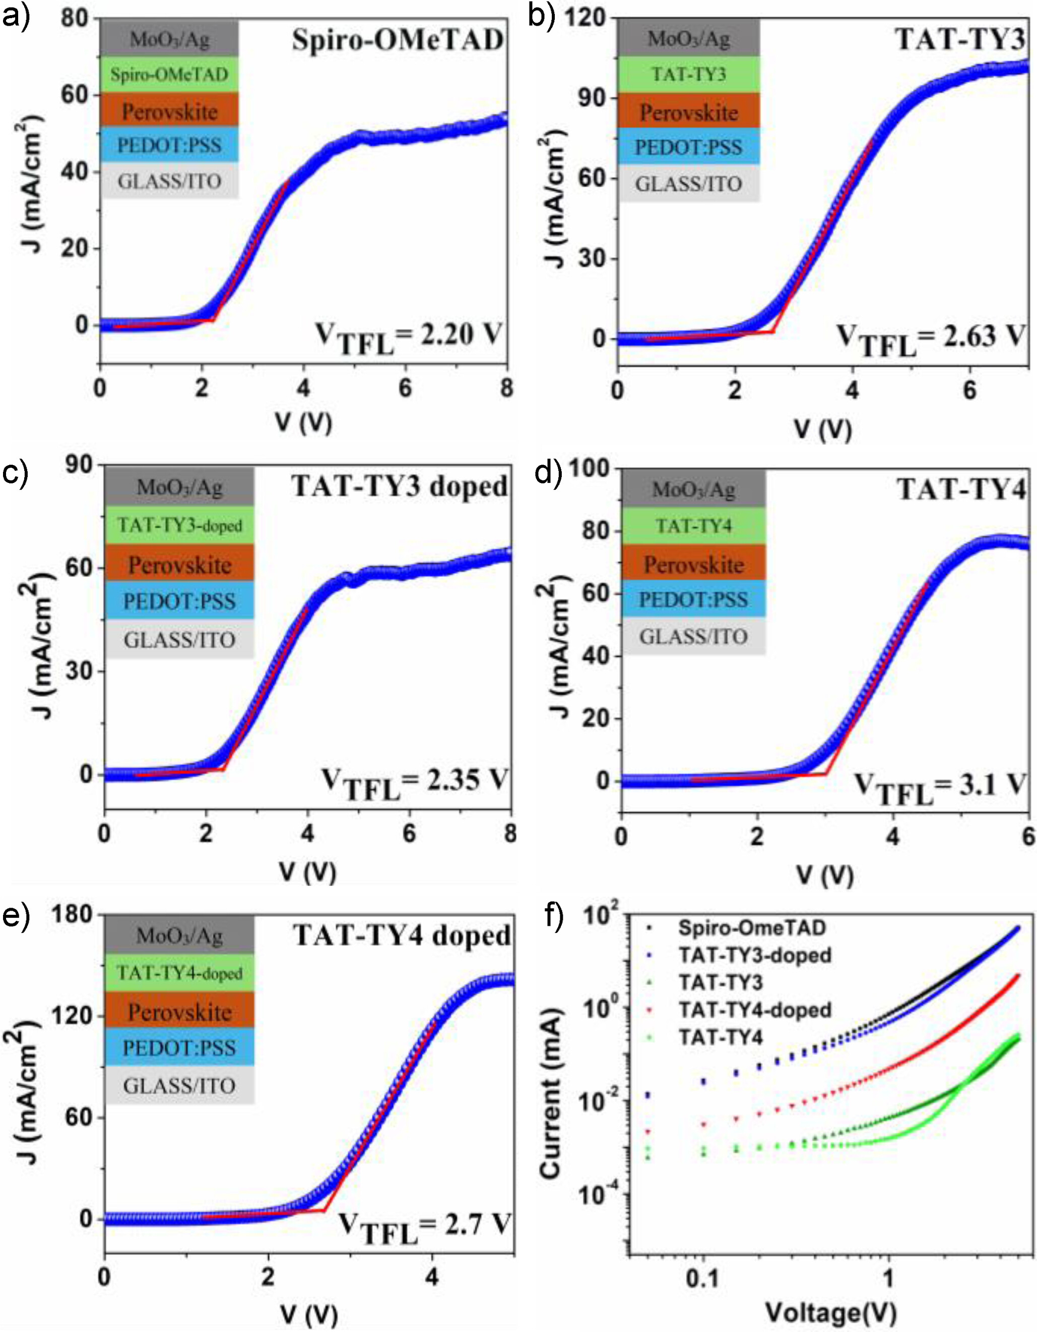
Ref | Good µ | TFL regime | Position V_{TFL} | Mention ions | Ohmic slope | SCLC slope | Report scan speed | Measure (+)/(-) voltages | Hysteresis sweep | pulsed-SCLC | Wrong conclusion
https://doi.org/10.1002/cptc.202400040 | 0 | 1 | 0 | 0 | 0 | 0 | 0 | 0 | 0 | 0

Slide 25
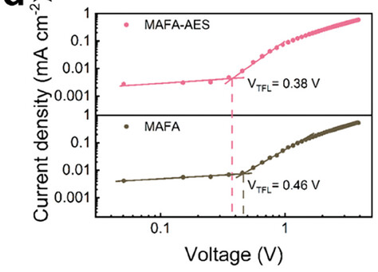
Ref | Good µ | TFL regime | Position V_{TFL} | Mention ions | Ohmic slope | SCLC slope | Report scan speed | Measure (+)/(-) voltages | Hysteresis sweep | pulsed-SCLC | Wrong conclusion
https://doi.org/10.1002/smll.202401456 |  | 1 | 0 | 0 | 0 | 0 | 0 | 0 | 0 | 0

Slide 26
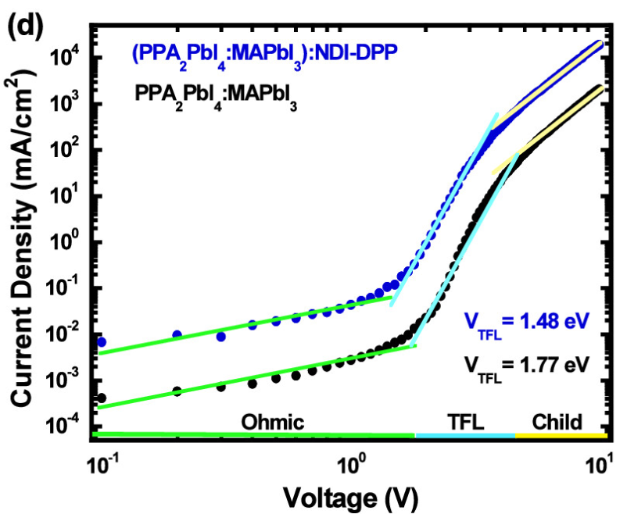
Ref | Good µ | TFL regime | Position V_{TFL} | Mention ions | Ohmic slope | SCLC slope | Report scan speed | Measure (+)/(-) voltages | Hysteresis sweep | pulsed-SCLC | Wrong conclusion
https://doi.org/10.1021/acsaelm.4c00622 | 0 | 1 | 0 | 0 | 1 | 0 | 0 | 0 | 0 | 0

Slide 27
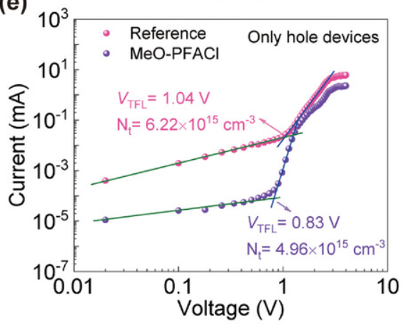
Ref | Good µ | TFL regime | Position V_{TFL} | Mention ions | Ohmic slope | SCLC slope | Report scan speed | Measure (+)/(-) voltages | Hysteresis sweep | pulsed-SCLC | Wrong conclusion
https://doi.org/10.1002/smll.202402197 |  | 1 | 0 | 0 | 0 | 0 | 0 | 0 | 0 | 0 | 1

Slide 28
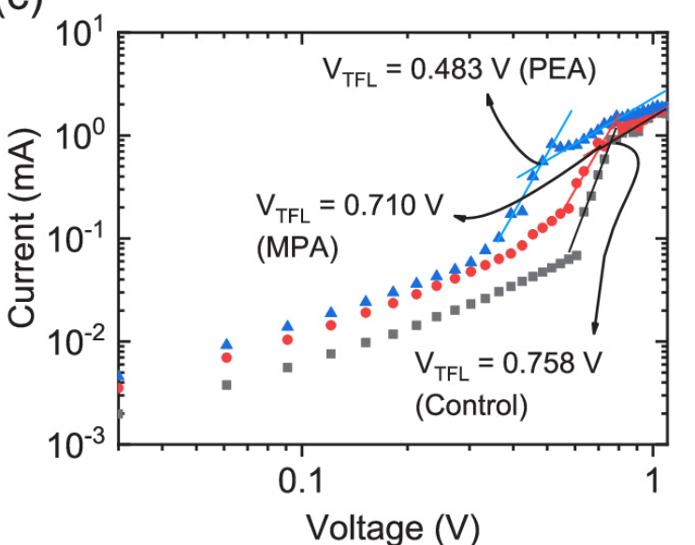
Ref | Good µ | TFL regime | Position V_{TFL} | Mention ions | Ohmic slope | SCLC slope | Report scan speed | Measure (+)/(-) voltages | Hysteresis sweep | pulsed-SCLC | Wrong conclusion
https://doi.org/10.1021/acsenergylett.4c00656 |  | 1 | 1 | 0 | 1 | 0 | 0 | 0 | 0 | 0 | 0

Slide 29
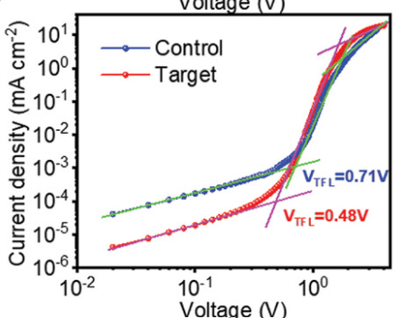
Ref | Good µ | TFL regime | Position V_{TFL} | Mention ions | Ohmic slope | SCLC slope | Report scan speed | Measure (+)/(-) voltages | Hysteresis sweep | pulsed-SCLC | Wrong conclusion
https://doi.org/10.1002/aenm.202400582 | 0 | 1 | 0 | 0 | 1 | 1 | 1 | 0 | 0 | 0 | 0

Slide 30
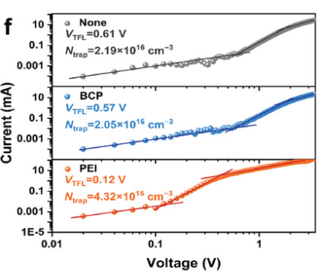
Ref | Good µ | TFL regime | Position V_{TFL} | Mention ions | Ohmic slope | SCLC slope | Report scan speed | Measure (+)/(-) voltages | Hysteresis sweep | pulsed-SCLC | Wrong conclusion
https://doi.org/10.1002/adma.202312704 |  | 1 | 0 | 0 | 1 | 1 | 4 | 0 | 0 | 0 | 0

Slide 31
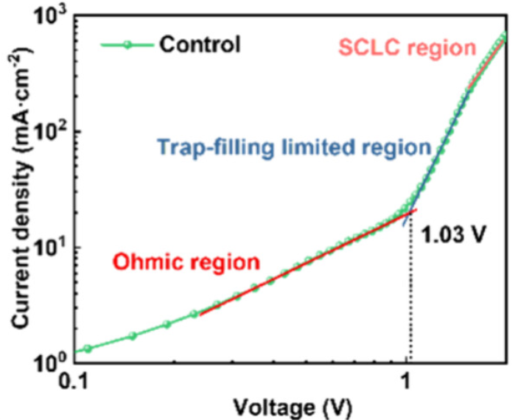
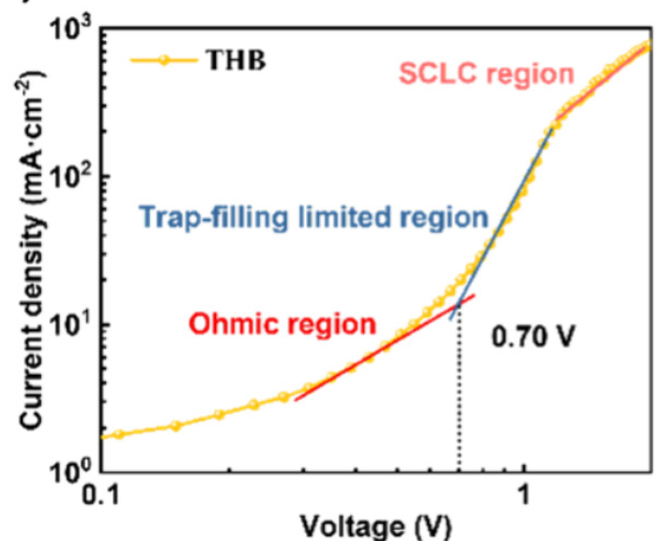
Ref | Good µ | TFL regime | Position V_{TFL} | Mention ions | Ohmic slope | SCLC slope | Report scan speed | Measure (+)/(-) voltages | Hysteresis sweep | pulsed-SCLC | Wrong conclusion
https://doi.org/10.1021/acsami.4c03260 |  | 1 | 0 | 0 | 0 | 0 | 0 | 0 | 0 | 0

Slide 32
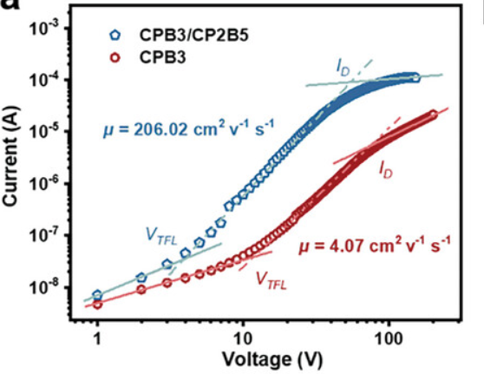
Ref | Good µ | TFL regime | Position V_{TFL} | Mention ions | Ohmic slope | SCLC slope | Report scan speed | Measure (+)/(-) voltages | Hysteresis sweep | pulsed-SCLC | Wrong conclusion
https://doi.org/10.1002/adfm.202401220 | 0 | 1 | 0 | 0 | 0 | 0 | 0 | 0 | 0 | 0

Slide 33
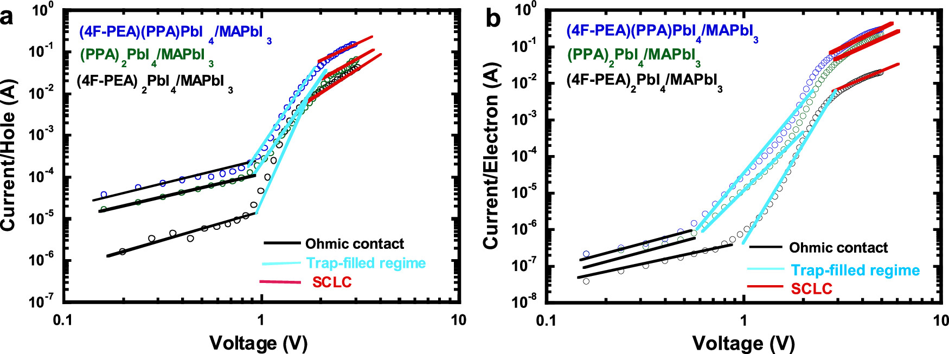
Ref | Good µ | TFL regime | Position V_{TFL} | Mention ions | Ohmic slope | SCLC slope | Report scan speed | Measure (+)/(-) voltages | Hysteresis sweep | pulsed-SCLC | Wrong conclusion
https://doi.org/10.1021/acsami.4c00288 | 0 | 1 | 0 | 0 | 1 | 0 | 0 | 0 | 0 | 0

Slide 34
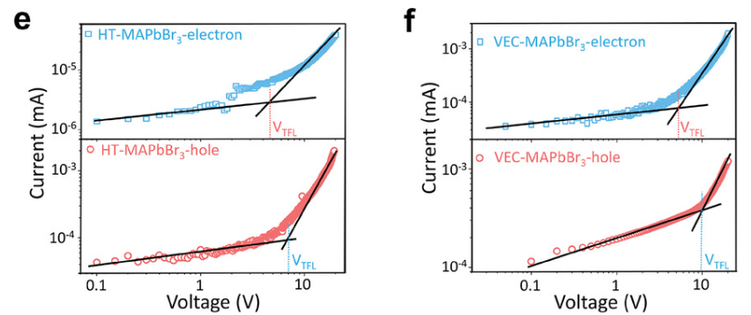
Ref | Good µ | TFL regime | Position V_{TFL} | Mention ions | Ohmic slope | SCLC slope | Report scan speed | Measure (+)/(-) voltages | Hysteresis sweep | pulsed-SCLC | Wrong conclusion
https://doi.org/10.1002/advs.202400150 | 0 | 1 | 0 | 0 | 0 | 0 | 0 | 0 | 0 | 0 | 1

Slide 35
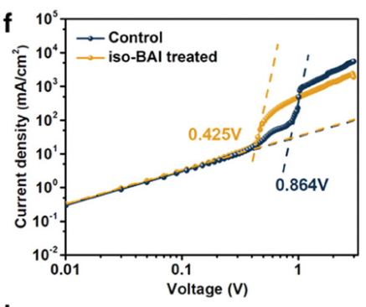
Ref | Good µ | TFL regime | Position V_{TFL} | Mention ions | Ohmic slope | SCLC slope | Report scan speed | Measure (+)/(-) voltages | Hysteresis sweep | pulsed-SCLC | Wrong conclusion
https://doi.org/10.1002/advs.202309668 |  | 1 | 0 | 0 | 1 | 1 | 0 | 0 | 0 | 0 | 0

Slide 36
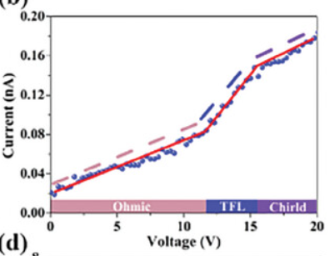
Ref | Good µ | TFL regime | Position V_{TFL} | Mention ions | Ohmic slope | SCLC slope | Report scan speed | Measure (+)/(-) voltages | Hysteresis sweep | pulsed-SCLC | Wrong conclusion
https://doi.org/10.1002/smll.202311969 |  |  | 0 | 0 | 0 | 0 | 0 | 0 | 0 | 0
Wrong axis…

Slide 37
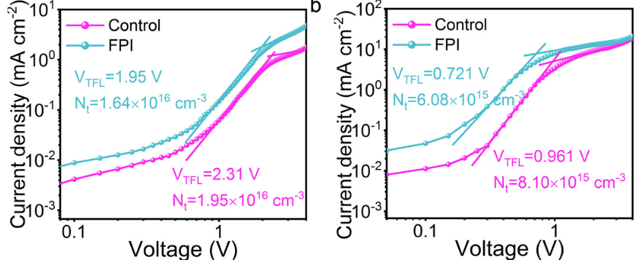
Ref | Good µ | TFL regime | Position V_{TFL} | Mention ions | Ohmic slope | SCLC slope | Report scan speed | Measure (+)/(-) voltages | Hysteresis sweep | pulsed-SCLC | Wrong conclusion
https://doi.org/10.1002/ange.202402904 |  | 1 | 1 | 0 | 0 | 0 | 0 | 0 | 0 | 0

Slide 38
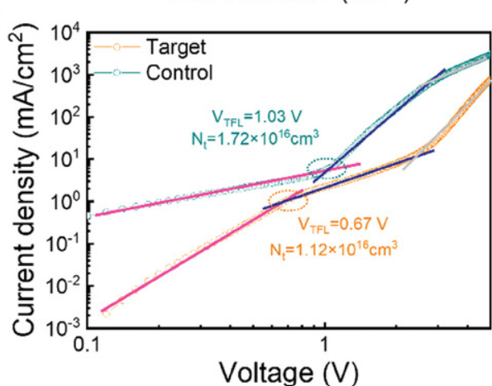
Ref | Good µ | TFL regime | Position V_{TFL} | Mention ions | Ohmic slope | SCLC slope | Report scan speed | Measure (+)/(-) voltages | Hysteresis sweep | pulsed-SCLC | Wrong conclusion
https://doi.org/10.1002/smtd.202301793 |  | 1 | 0 | 0 | 0 | 0 | 0 | 0 | 0 | 0

Slide 39
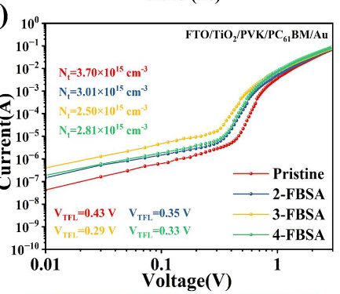
Ref | Good µ | TFL regime | Position V_{TFL} | Mention ions | Ohmic slope | SCLC slope | Report scan speed | Measure (+)/(-) voltages | Hysteresis sweep | pulsed-SCLC | Wrong conclusion
https://doi.org/10.1016/j.cej.2024.150382 |  | 1 | 0 | 0 | 1 | 1 | 0 | 0 | 0 | 0 | 1

Slide 40
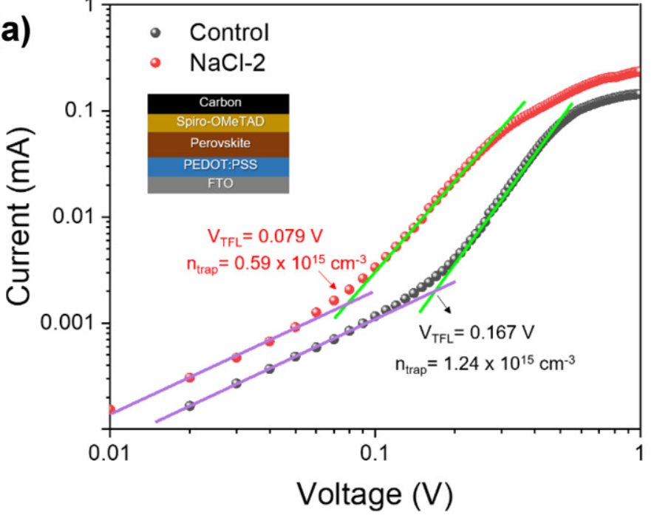
Ref | Good µ | TFL regime | Position V_{TFL} | Mention ions | Ohmic slope | SCLC slope | Report scan speed | Measure (+)/(-) voltages | Hysteresis sweep | pulsed-SCLC | Wrong conclusion
https://doi.org/10.1021/acsaem.3c02369 |  | 1 | 0 | 0 | 1 | 0 | 0 | 0 | 0 | 0

Slide 41
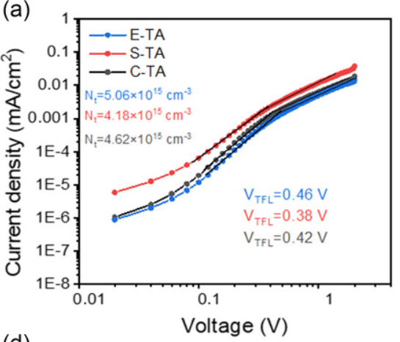
Ref | Good µ | TFL regime | Position V_{TFL} | Mention ions | Ohmic slope | SCLC slope | Report scan speed | Measure (+)/(-) voltages | Hysteresis sweep | pulsed-SCLC | Wrong conclusion
https://doi.org/10.1002/ente.202301316 |  | 1 | 1 | 0 | 1 | 1 | 0 | 0 | 0 | 0

Slide 42
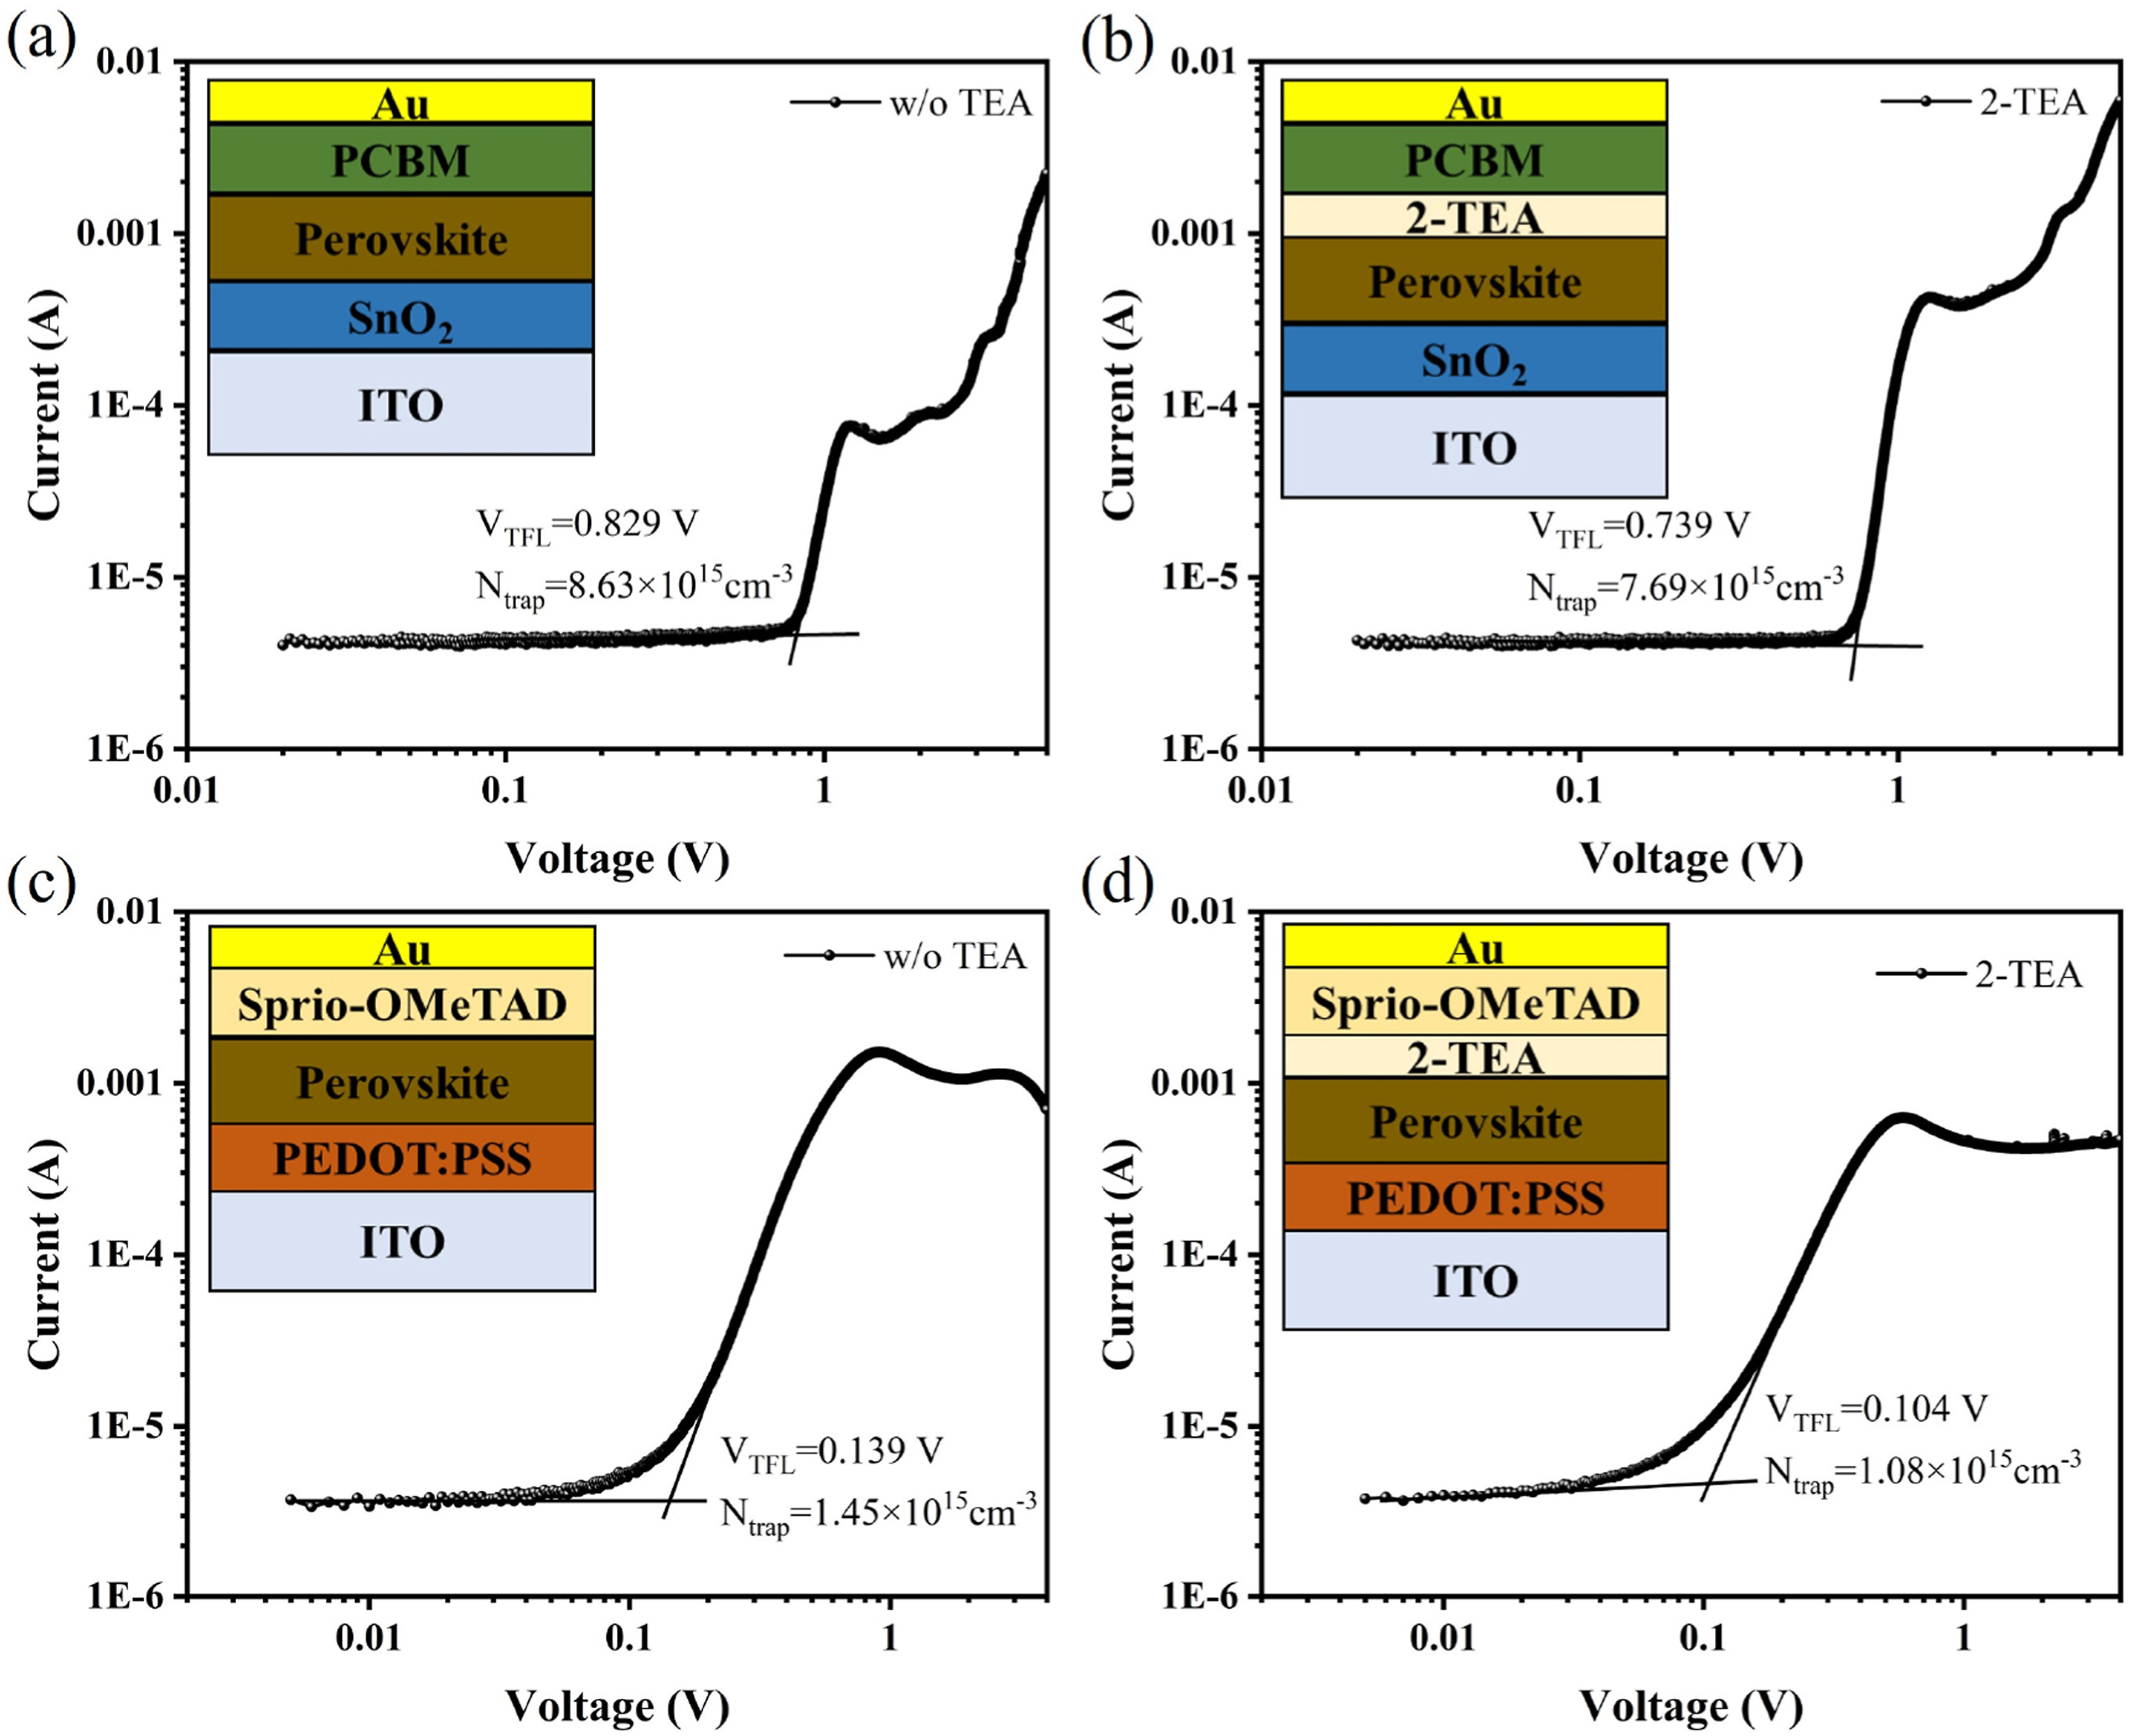
Ref | Good µ | TFL regime | Position V_{TFL} | Mention ions | Ohmic slope | SCLC slope | Report scan speed | Measure (+)/(-) voltages | Hysteresis sweep | pulsed-SCLC | Wrong conclusion
https://doi.org/10.1016/j.orgel.2024.107026 |  | 0 | 0 | 0 | 0 | 0 | 0 | 0 | 0 | 0 | 1

Slide 43
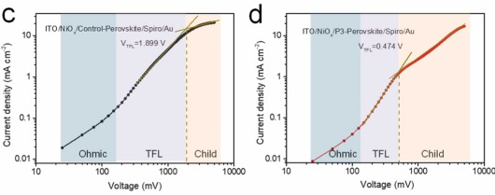
Ref | Good µ | TFL regime | Position V_{TFL} | Mention ions | Ohmic slope | SCLC slope | Report scan speed | Measure (+)/(-) voltages | Hysteresis sweep | pulsed-SCLC | Wrong conclusion
https://doi.org/10.1016/j.nanoen.2024.109423 |  | 1 | 1 | 0 | 1 | 0 | 0 | 0 | 0 | 0

Slide 44
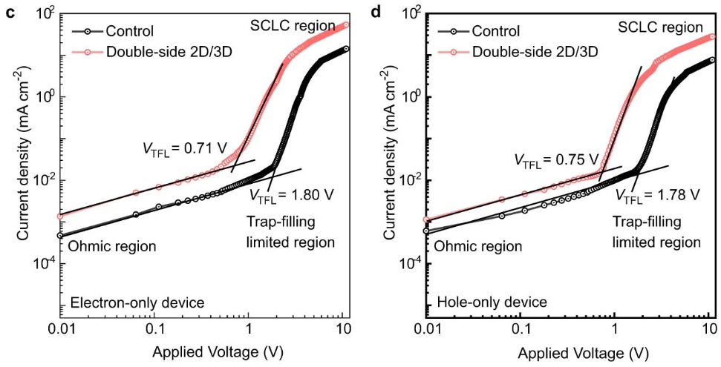
Ref | Good µ | TFL regime | Position V_{TFL} | Mention ions | Ohmic slope | SCLC slope | Report scan speed | Measure (+)/(-) voltages | Hysteresis sweep | pulsed-SCLC | Wrong conclusion
https://doi.org/10.1038/s41586-024-07189-3 |  | 1 | 0 | 1 | 0 | 0 | 1 | 0 | 0 | 0

Slide 45
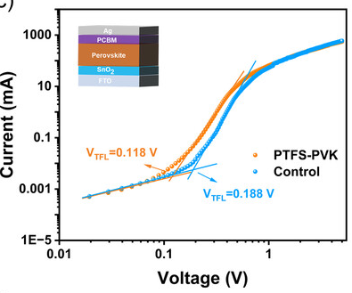
Ref | Good µ | TFL regime | Position V_{TFL} | Mention ions | Ohmic slope | SCLC slope | Report scan speed | Measure (+)/(-) voltages | Hysteresis sweep | pulsed-SCLC | Wrong conclusion
https://doi.org/10.1002/solr.202400016 |  | 1 | 0 | 0 | 1 | 0 | 1 | 0 | 0 | 0

Slide 46
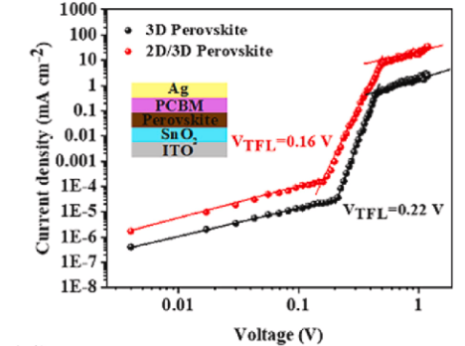
Ref | Good µ | TFL regime | Position V_{TFL} | Mention ions | Ohmic slope | SCLC slope | Report scan speed | Measure (+)/(-) voltages | Hysteresis sweep | pulsed-SCLC | Wrong conclusion
https://doi.org/10.1016/j.mssp.2024.108185 |  | 1 | 0 | 0 | 1 | 1 | 0 | 0 | 0 | 0 | 1

Slide 47
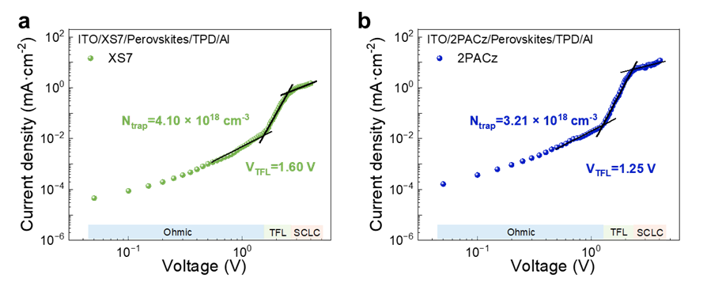
Ref | Good µ | TFL regime | Position V_{TFL} | Mention ions | Ohmic slope | SCLC slope | Report scan speed | Measure (+)/(-) voltages | Hysteresis sweep | pulsed-SCLC | Wrong conclusion
https://doi.org/10.1016/j.apsusc.2024.159643 |  | 1 | 0 | 0 | 0 | 1 | 0 | 0 | 0 | 0 | 0

Slide 48
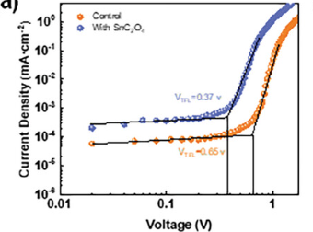
Ref | Good µ | TFL regime | Position V_{TFL} | Mention ions | Ohmic slope | SCLC slope | Report scan speed | Measure (+)/(-) voltages | Hysteresis sweep | pulsed-SCLC | Wrong conclusion
https://doi.org/10.1002/adma.202312170 | 0 | 1 | 0 | 0 | 0 | 0 | 1 | 0 | 0 | 0

Slide 49
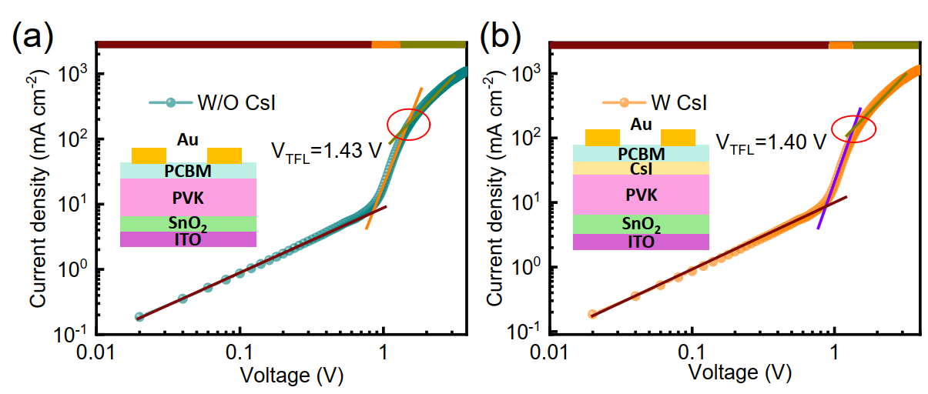
Ref | Good µ | TFL regime | Position V_{TFL} | Mention ions | Ohmic slope | SCLC slope | Report scan speed | Measure (+)/(-) voltages | Hysteresis sweep | pulsed-SCLC | Wrong conclusion
https://doi.org/10.1002/solr.202300739 |  | 1 | 2 | 0 | 1 | 1 | 0 | 0 | 0 | 0 | 0

Slide 50
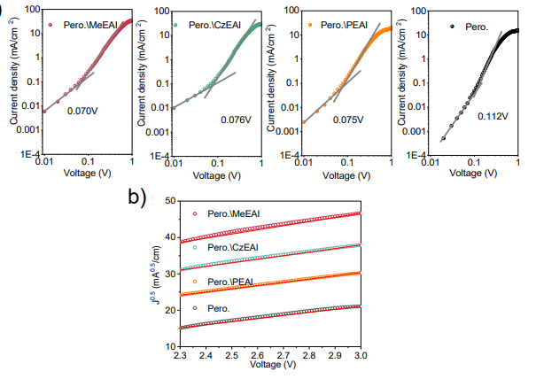
Ref | Good µ | TFL regime | Position V_{TFL} | Mention ions | Ohmic slope | SCLC slope | Report scan speed | Measure (+)/(-) voltages | Hysteresis sweep | pulsed-SCLC | Wrong conclusion
https://doi.org/10.1021/acsenergylett.3c02357 | 0 | 1 | 0 | 0 | 0 | 0 | 0 | 0 | 0 | 0 | 1

Slide 51
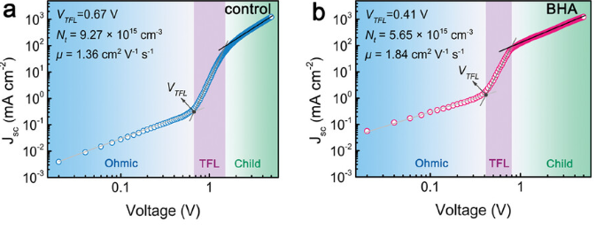
Ref | Good µ | TFL regime | Position V_{TFL} | Mention ions | Ohmic slope | SCLC slope | Report scan speed | Measure (+)/(-) voltages | Hysteresis sweep | pulsed-SCLC | Wrong conclusion
https://doi.org/10.1002/adma.202309193 | 0 | 1 | 0 | 0 | 1 | 0 | 1 | 0 | 0 | 0

Slide 52

Ref | Good µ | TFL regime | Position V_{TFL} | Mention ions | Ohmic slope | SCLC slope | Report scan speed | Measure (+)/(-) voltages | Hysteresis sweep | pulsed-SCLC | Wrong conclusion
https://doi.org/10.1002/smll.202309009 |  | 1 | 0 | 0 | 0 | 0 | 0 | 0 | 0 | 0

Slide 53

Ref | Good µ | TFL regime | Position V_{TFL} | Mention ions | Ohmic slope | SCLC slope | Report scan speed | Measure (+)/(-) voltages | Hysteresis sweep | pulsed-SCLC | Wrong conclusion
https://doi.org/10.1039/D4EE01647E |  | 1 | 0 | 0 | 0 | 0 | 0 | 0 | 0 | 0

